Slide 1



Connecting People and Data to Improve Lives
January 17, 2020
Threshold Analysis for Somalia
Eleonore Fournier-Tombs, Data Scientist

Slide 2

Overview:
Summary of methodology
National-level analysis
Sub-national analysis
Next steps

Slide 3
Summary of methodology
Data sources:
IPC data extracted from http://www.ipcinfo.org
Threshold calculations:
At least 20% of the population projected to be at IPC 3 or more
One of the following two options:
An increase of 5% projected for IPC 3 or more OR
2.5% of the population projected to be at IPC 4 or more

Slide 4
National Level Analysis

Slide 5
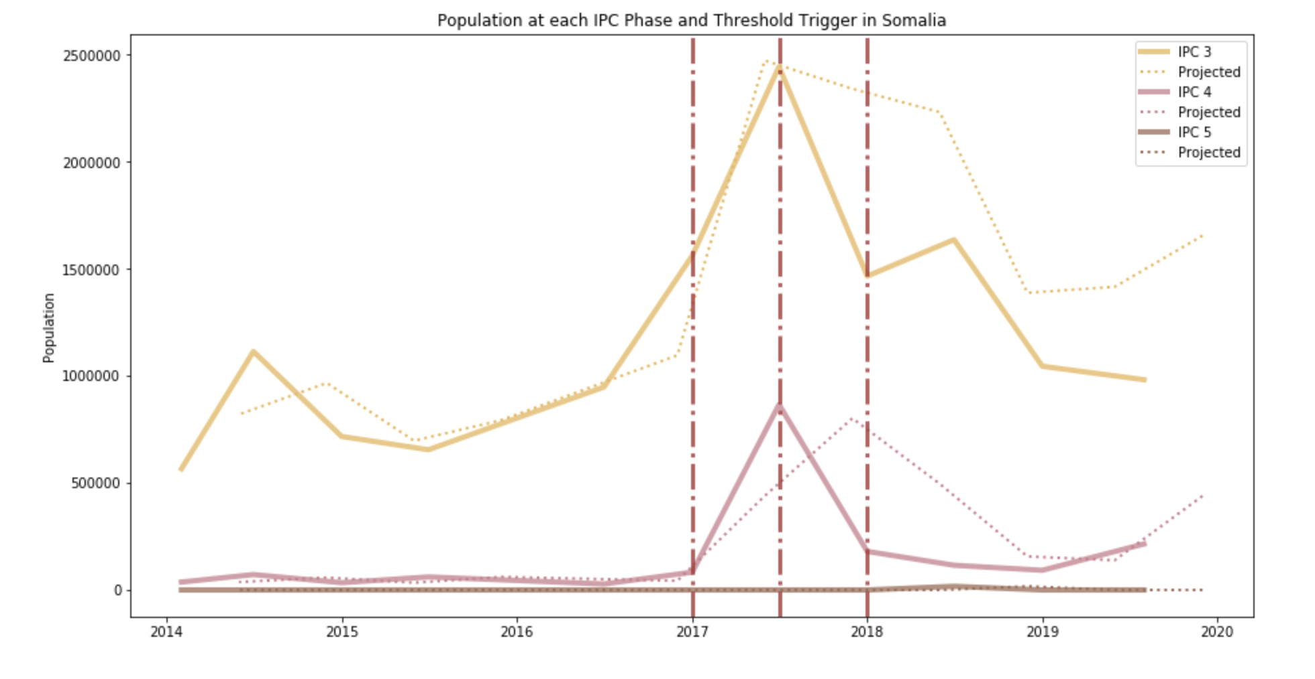
National Level Analysis

Slide 6
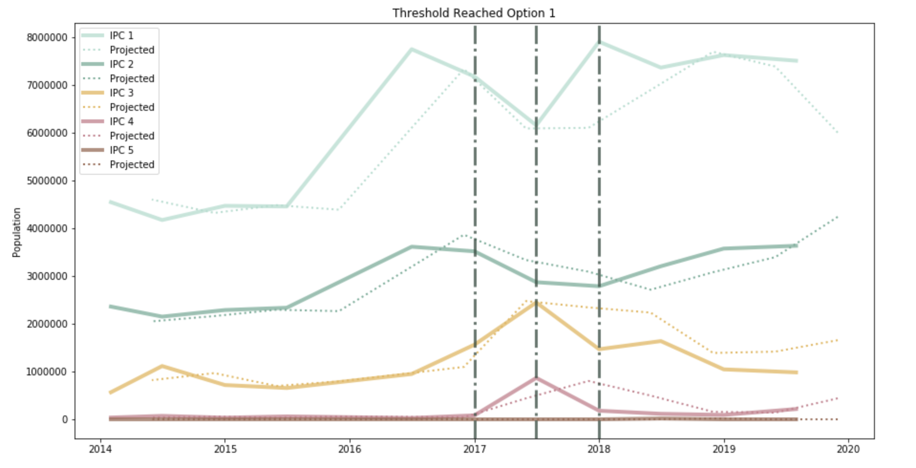
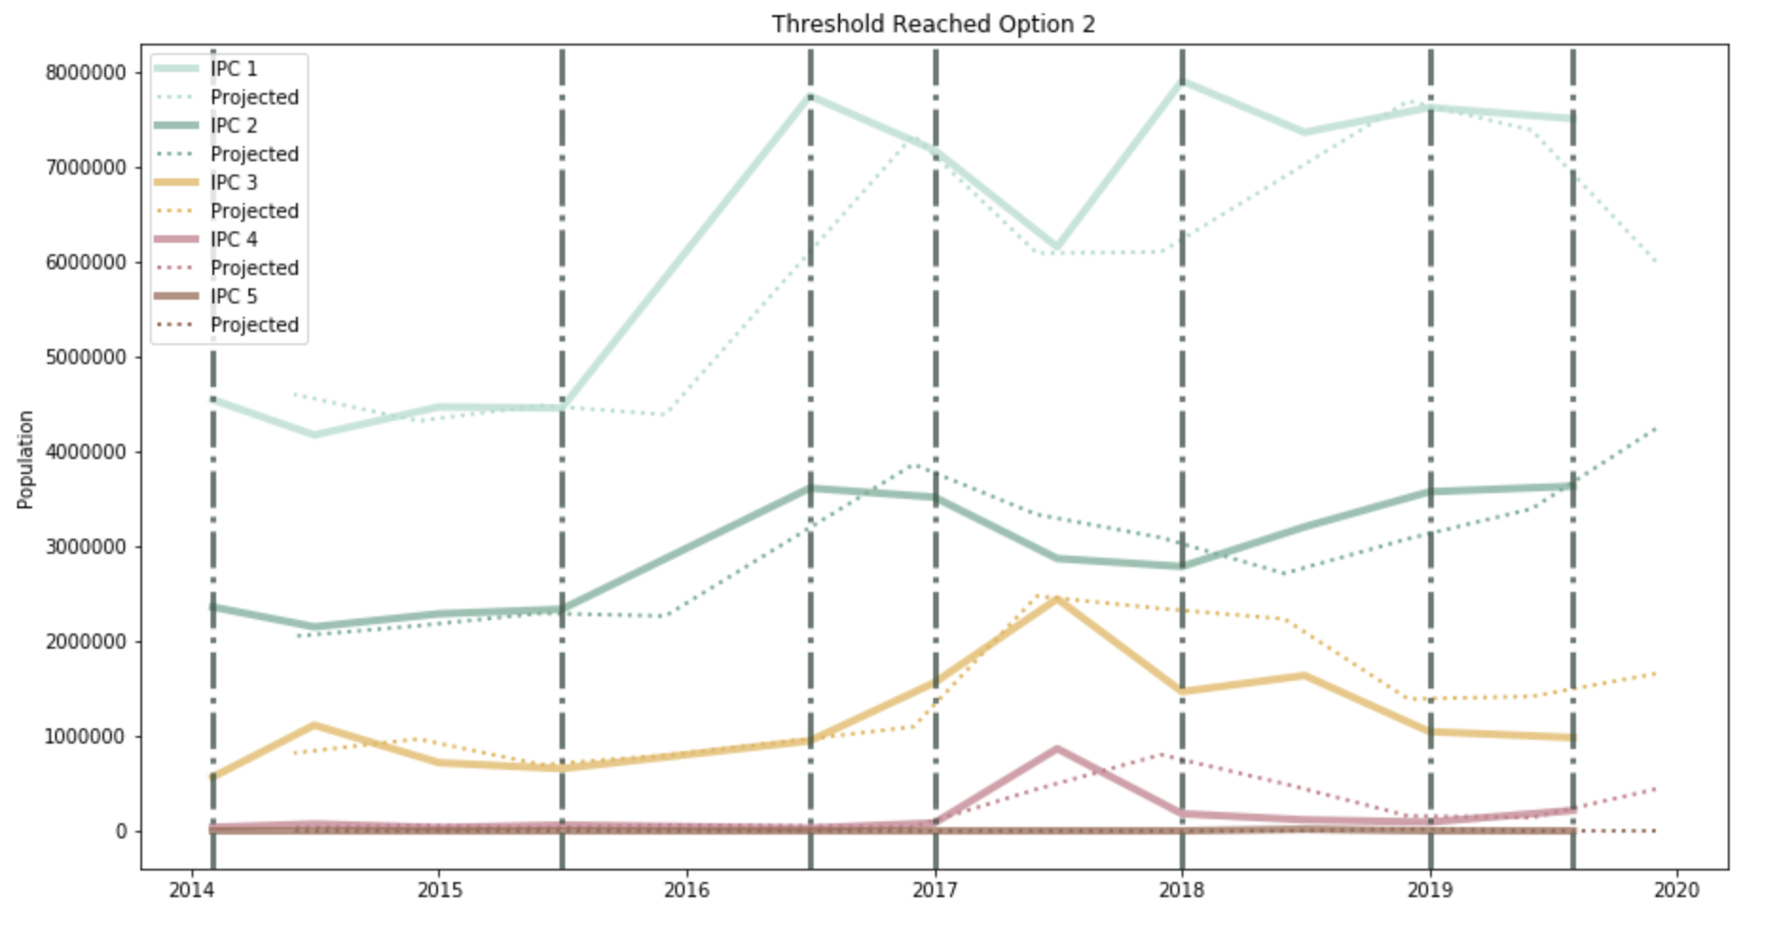
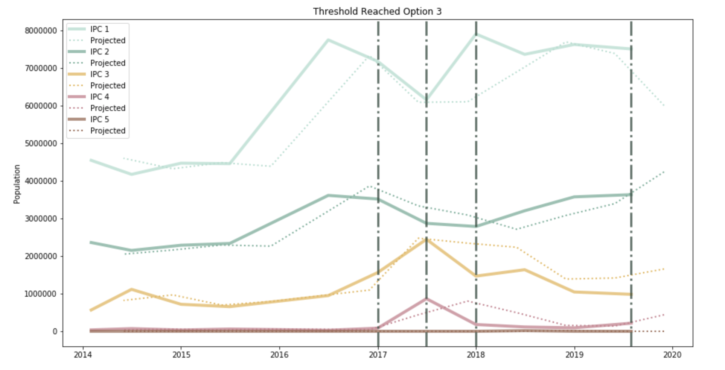
National Level Analysis - Breakdown of Threshold Components
Option 1: At least 20% of the population projected to be at IPC 3 or more
Option 2: An increase of 5% projected for IPC 3 or more
Option 3: 2.5% of the population projected to be at IPC 4 or more

Slide 7
Sub-National Level Analysis

Slide 8
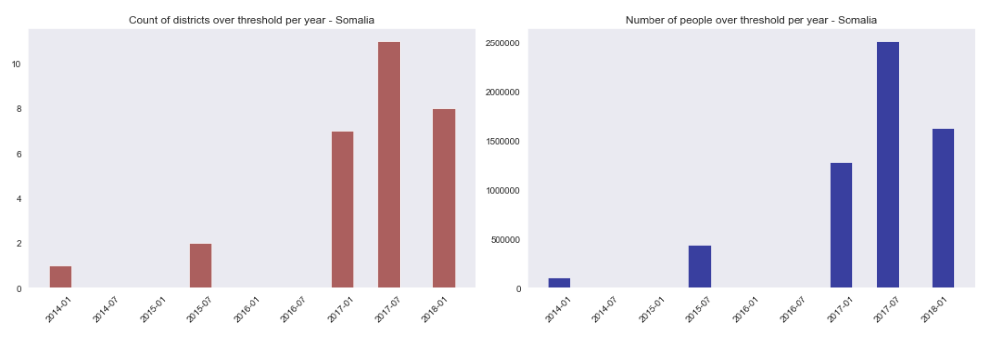
Sub-National Level Analysis

Slide 9
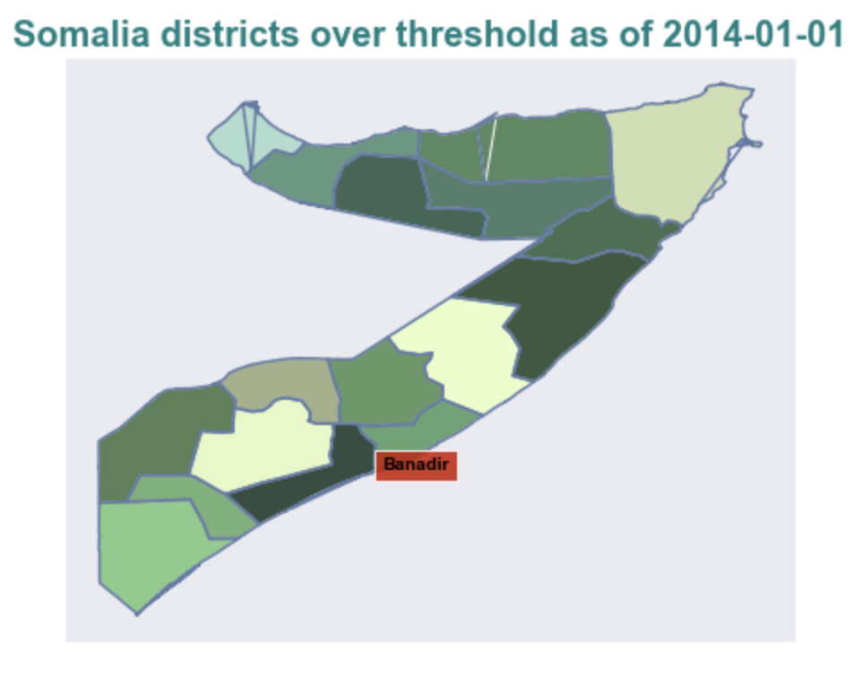
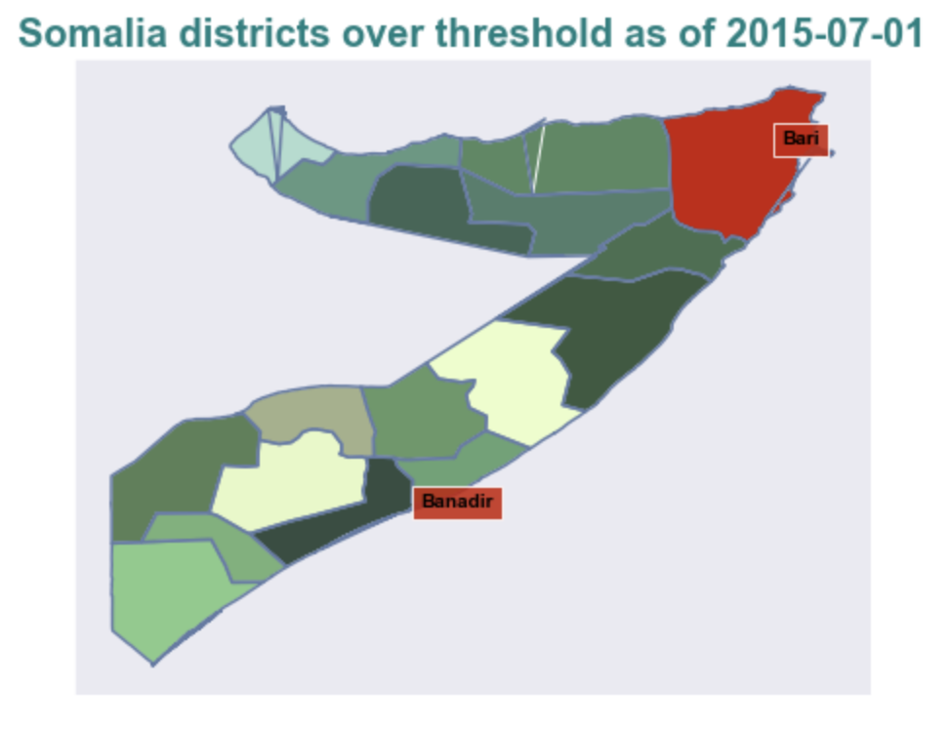
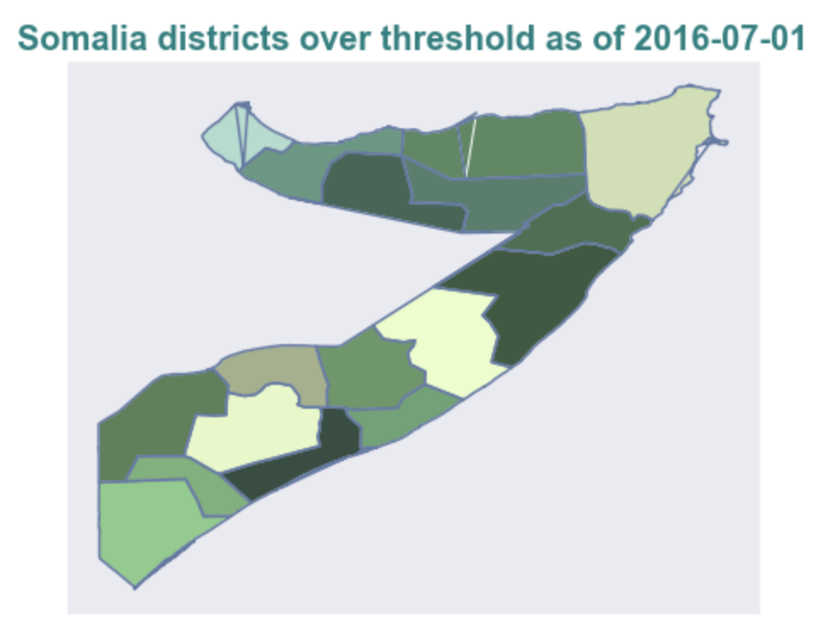
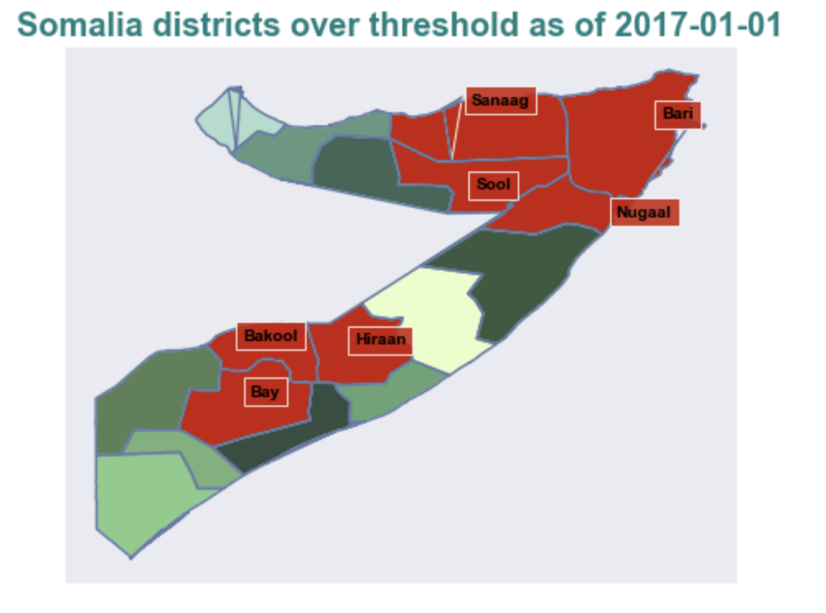
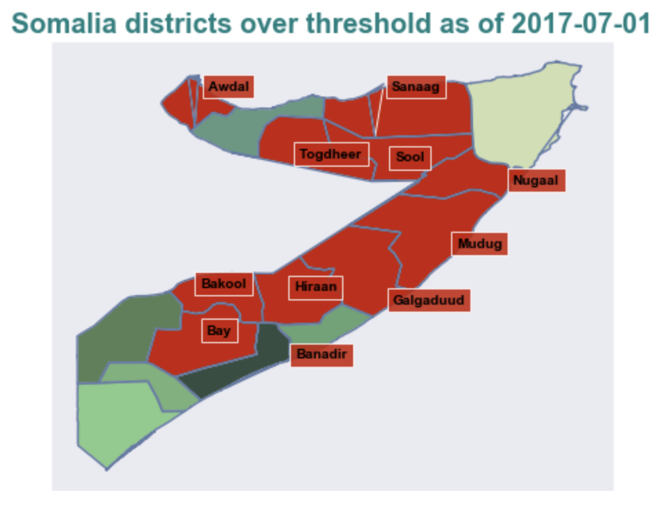
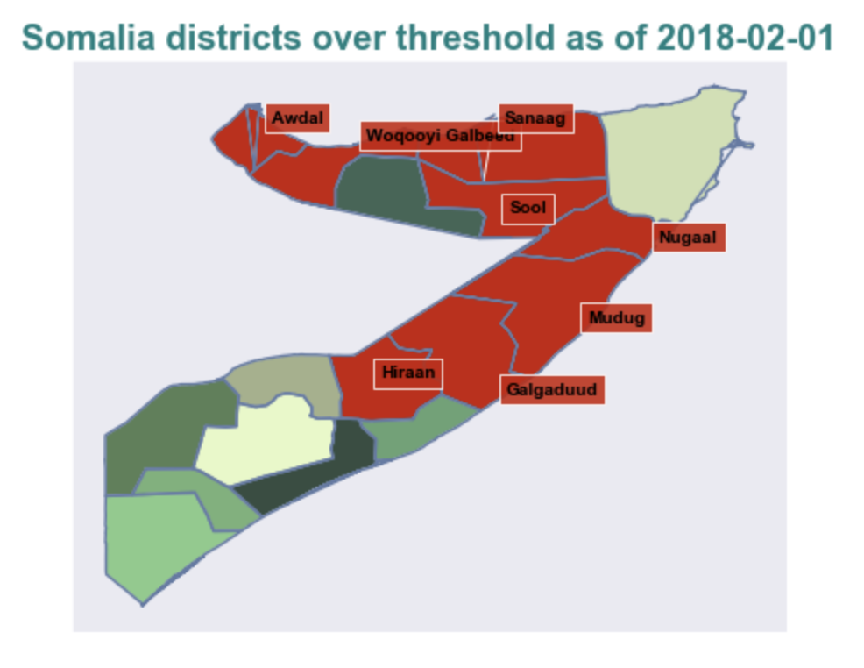
Sub-National Level Analysis

Slide 10
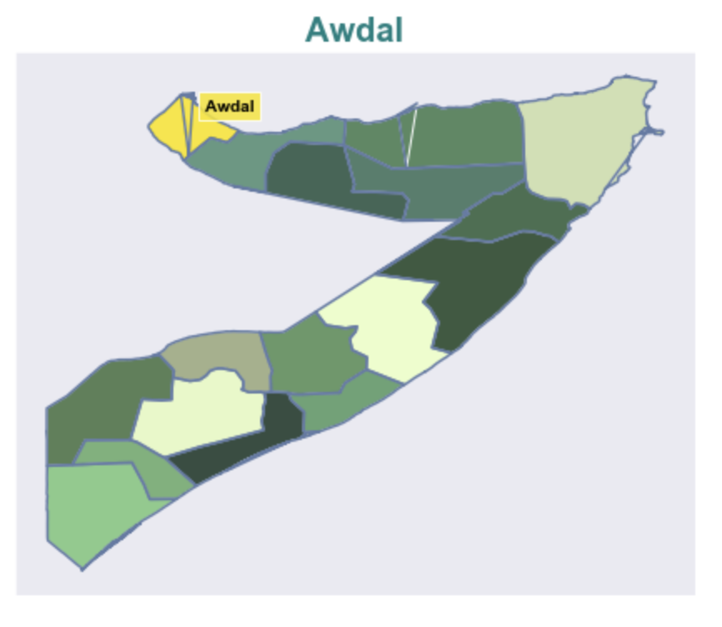
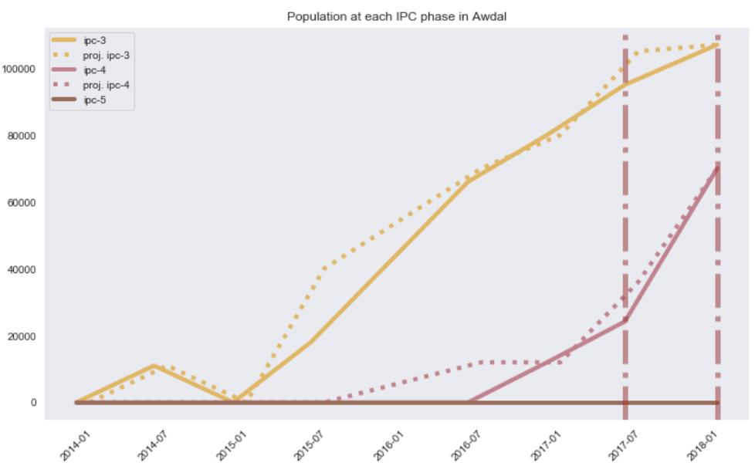
Sub-National Level Analysis - Awdal

Slide 11
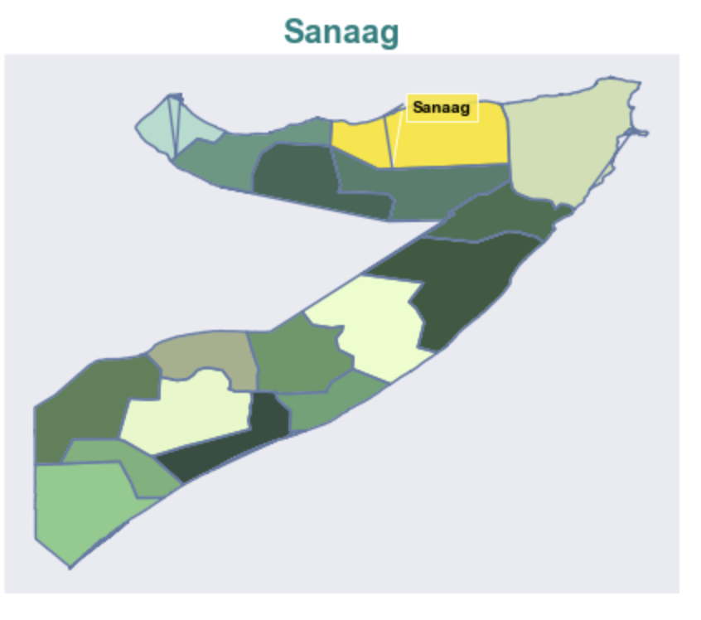
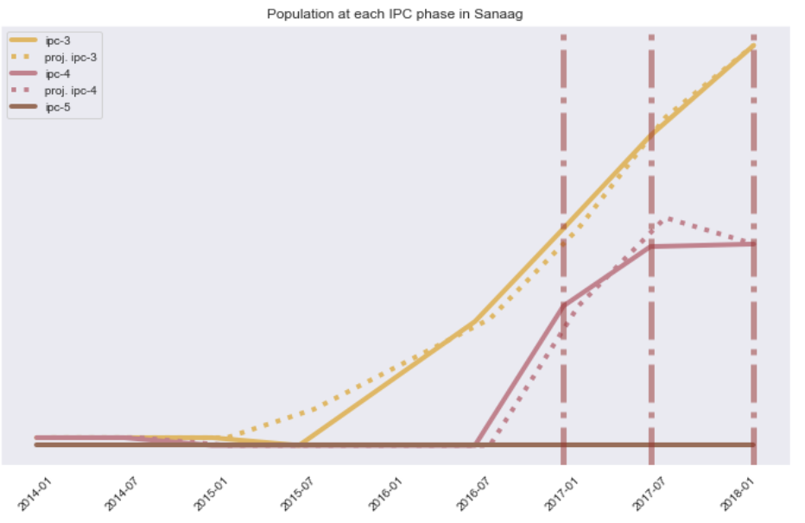
Sub-National Level Analysis - Sanaag

Slide 12
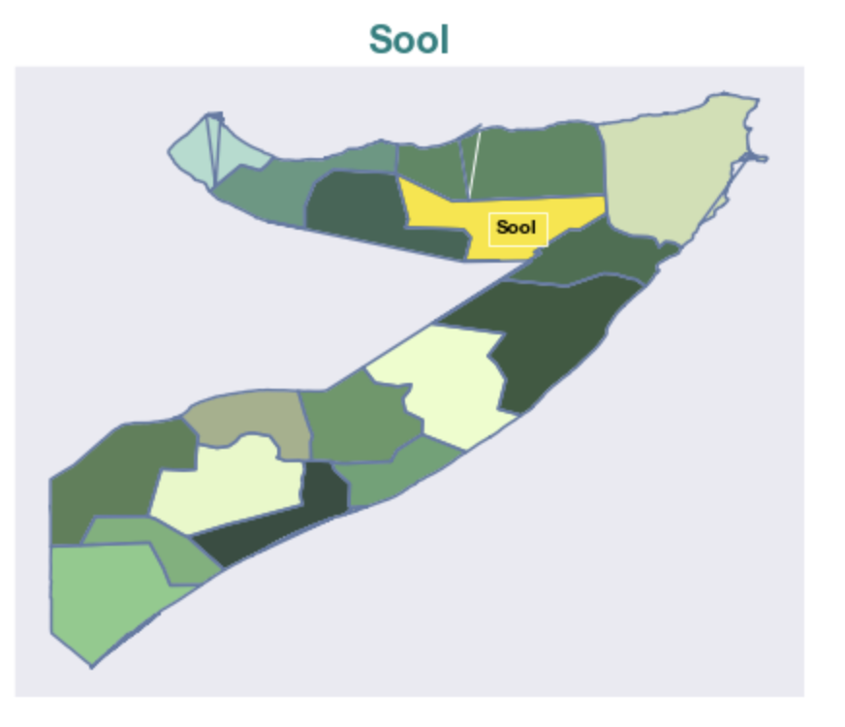
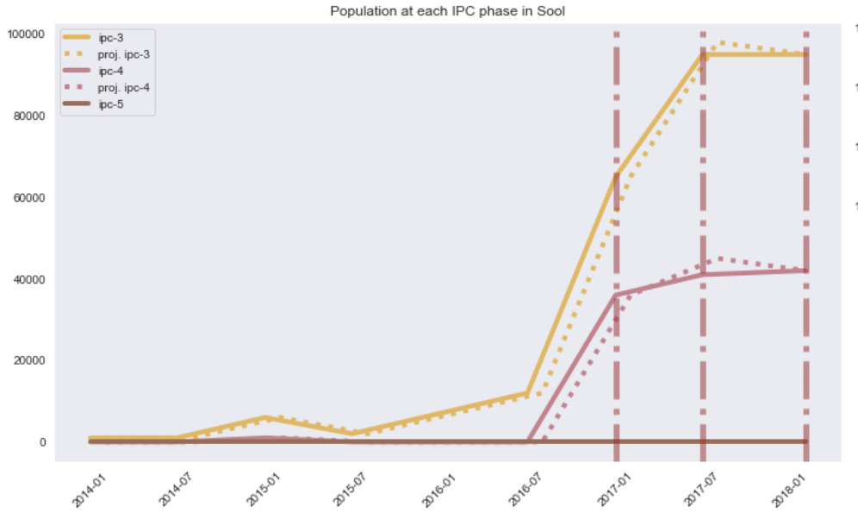
Sub-National Level Analysis - Sool

Slide 13
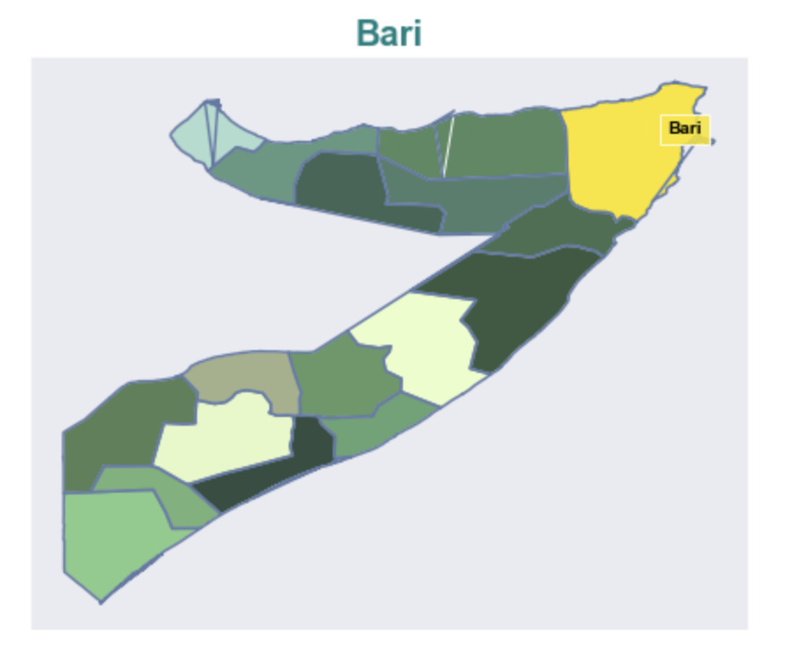
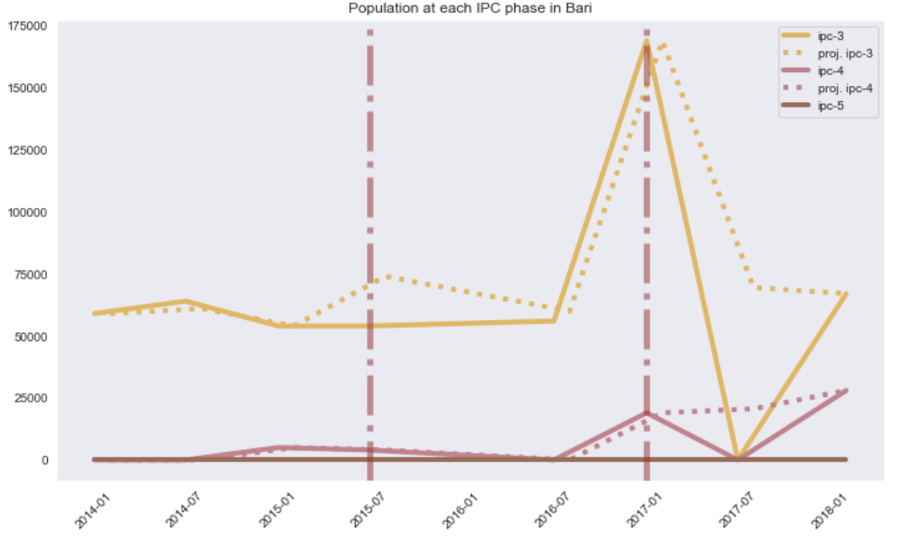
Sub-National Level Analysis - Bari

Slide 14
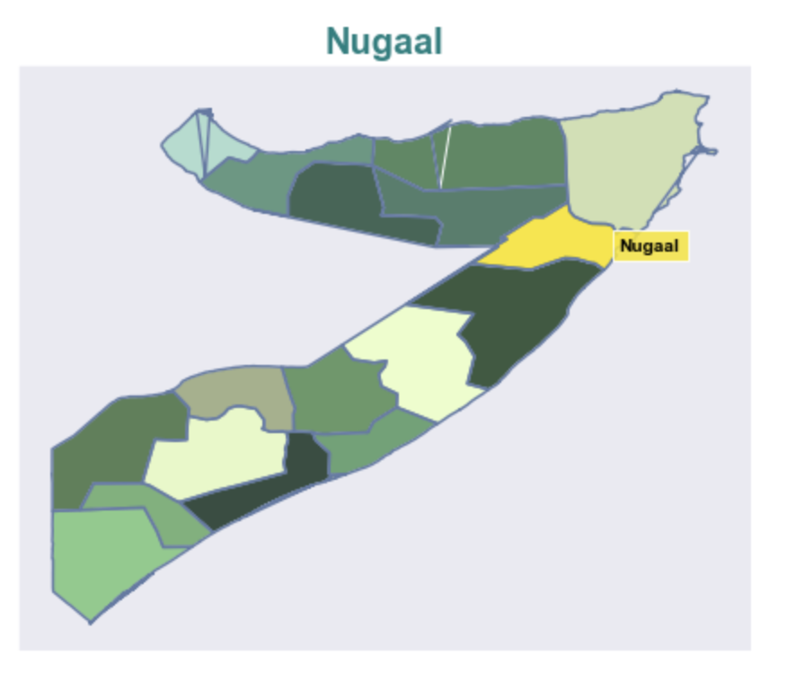
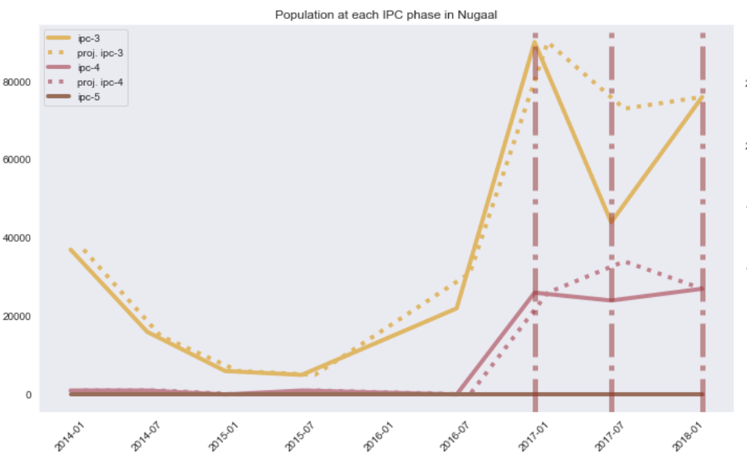
Sub-National Level Analysis - Nugaal

Slide 15
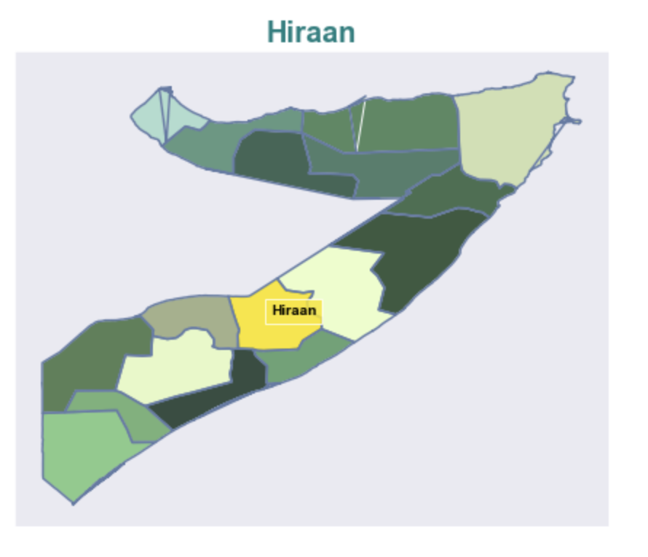
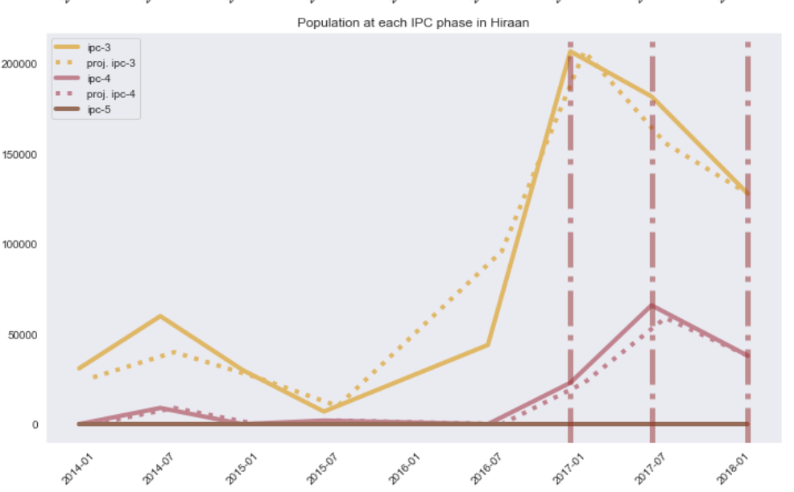
Sub-National Level Analysis - Hiraan

Slide 16
Next steps:
At the sub-national level, examining which parts of the thresholds were triggered
Identifying correlated datasets to threshold analysis
Refining the analysis and understanding the difference between this and the WB analysis

Slide 17

Thank you
centre.humdata.org humdata | centrehumdata@un.org

